Slide 1


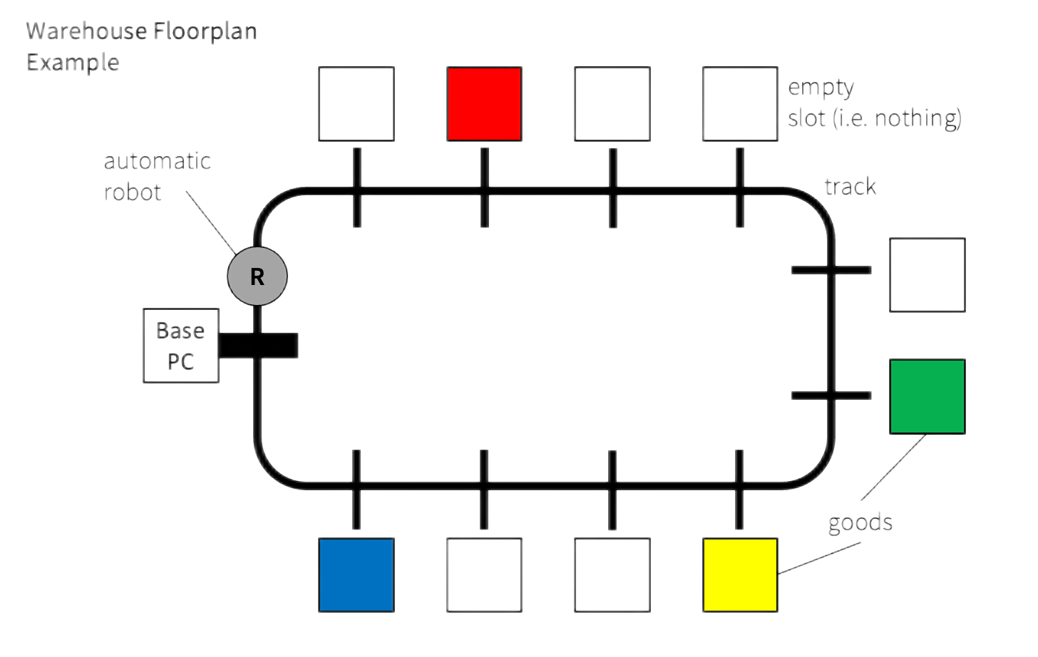
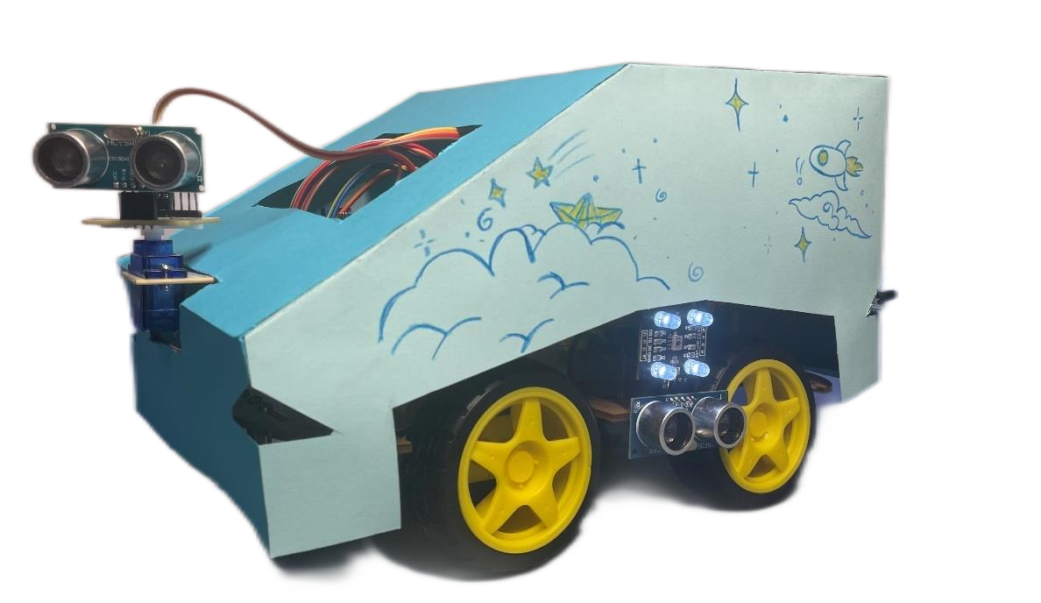
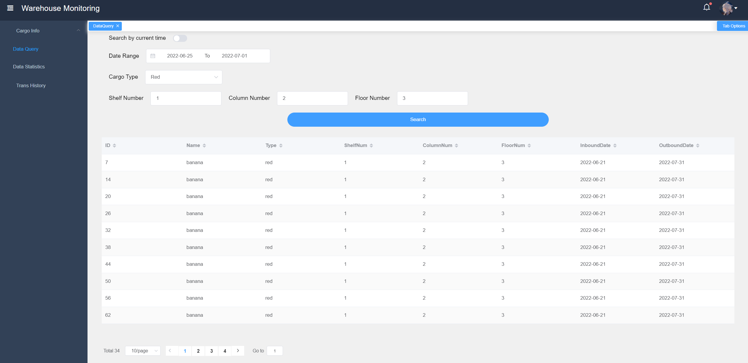
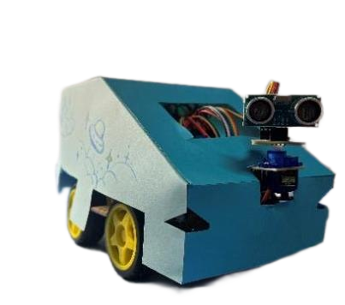
Build
Design
And
And
Design
GROUP 16
Build
Build

Slide 2
Build & Design
Automated Robots Design
（Telecom）
01
02
Web
Design
（E-Commerce）
CONTENTS
CONTENTS
03
Database and
Interface
（IoT）
04
Summary
GROUP 16

Slide 3

Automated Robots Design
Design of the circuit and implementation of the functions
Team members：
Tangxun Wu
Boyang He
Guanyi Lin
Donngze Sun
Weiping Kong
GROUP 16

Slide 4
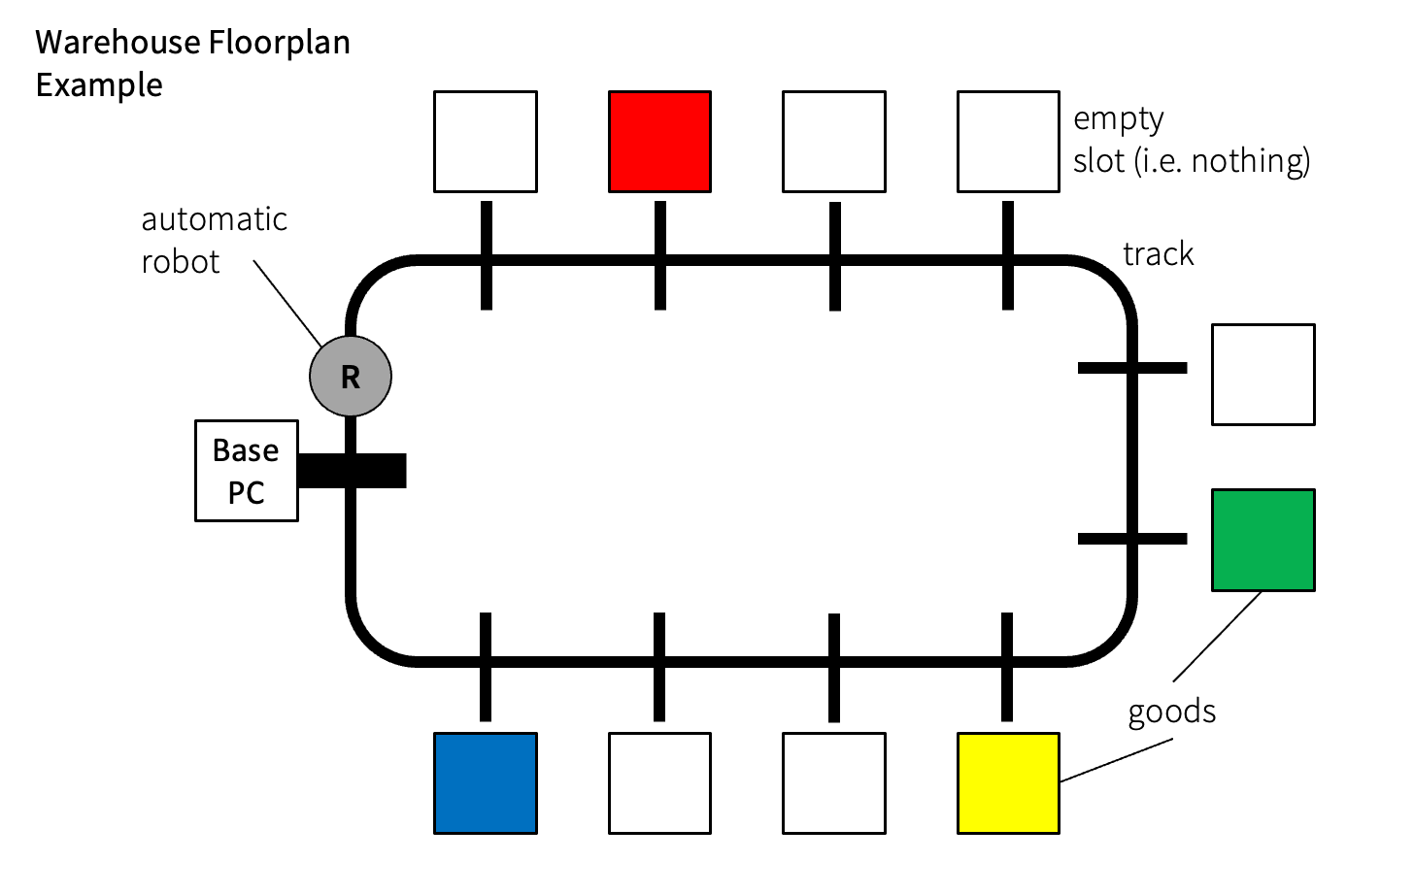
Mission Requirements
Automated Robots Design
Basic requirements:
1. follows black line tracks on the floor;
2. stops at marked positions and records the position of the
goods of four possible colours (red, blue, yellow and
green) along the track;
3. stops when it is back to the base PC;
4. offloads the recorded positions to the hardware-database
interface software
• Possible advanced functions:
– connect to the host PC wirelessly and transmit the positions
of the goods in real time.
– self-designed other functions.
Effective marketing
Innovative
design
Careful planning
Comprehensive documentation
Excellent teamwork
GROUP 16

Slide 5
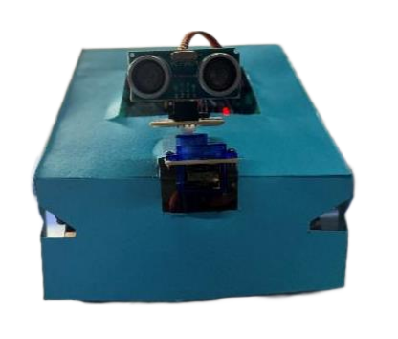
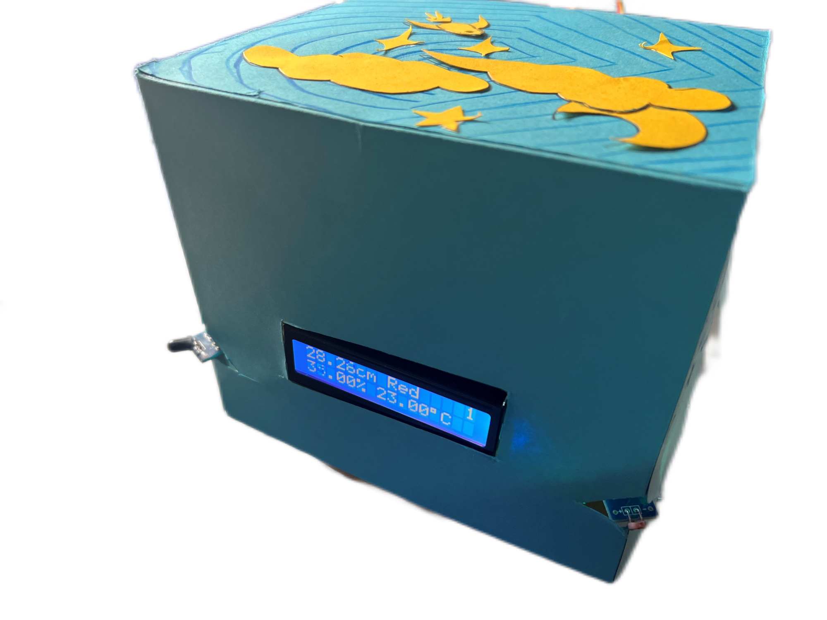
Appearance
GROUP 16

Slide 6

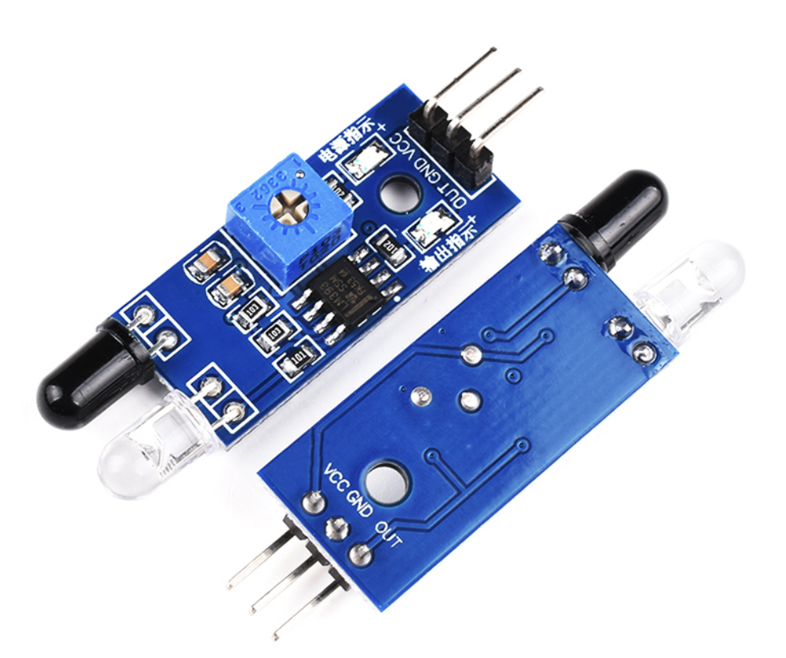
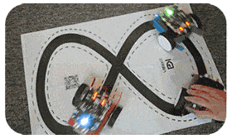
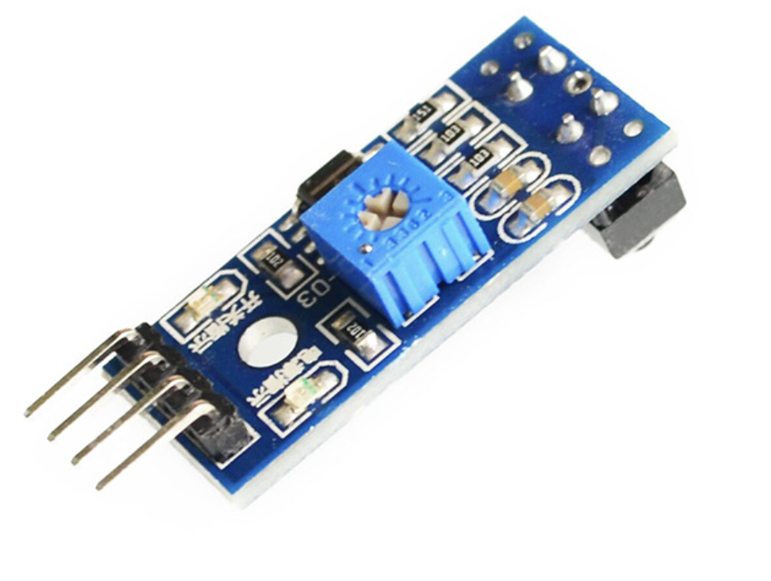
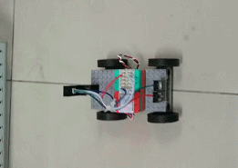
Basic Functions
Do infrared tracking
Obstacle avoidance
Useful for normal running!
Sensor for
Infrared Obstacle
Avoidance
Sensor for
Color Identification
GROUP 16

Slide 7

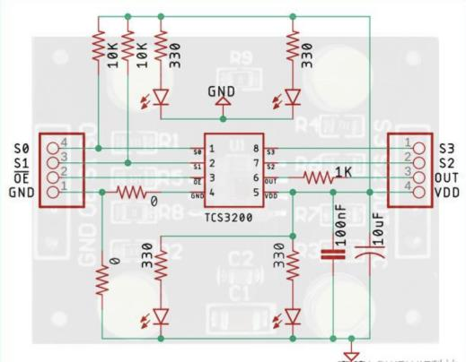

Basic Functions
3. Identify the cargos via color
4. Warehouse location counting
Optimized algorithm for accuracy!
Sensor for
Infrared Tracking
Ultrasonic Ranging
& Warehouse Counting
Transform RGB into HSV for identifying color.
Apply distance to do if-else judgement for
better warehouse counting.
GROUP 16

Slide 8

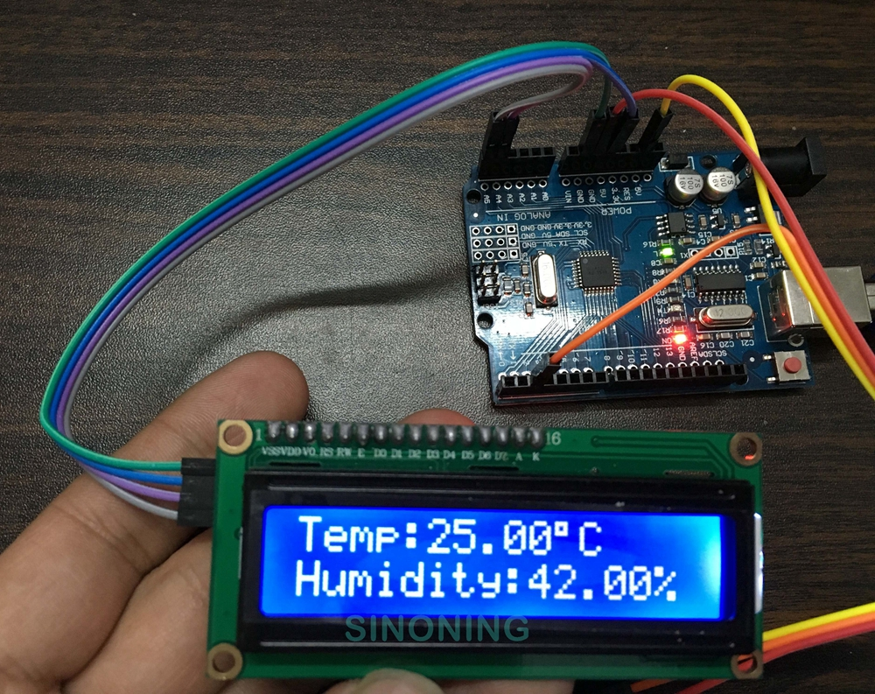
Innovation 1: Environmental monitoring
Detect indoor humidity
Measure the temperature
For better cargo storage!
Environmental
Parameter
Acquisition sensor
GROUP 16

Slide 9
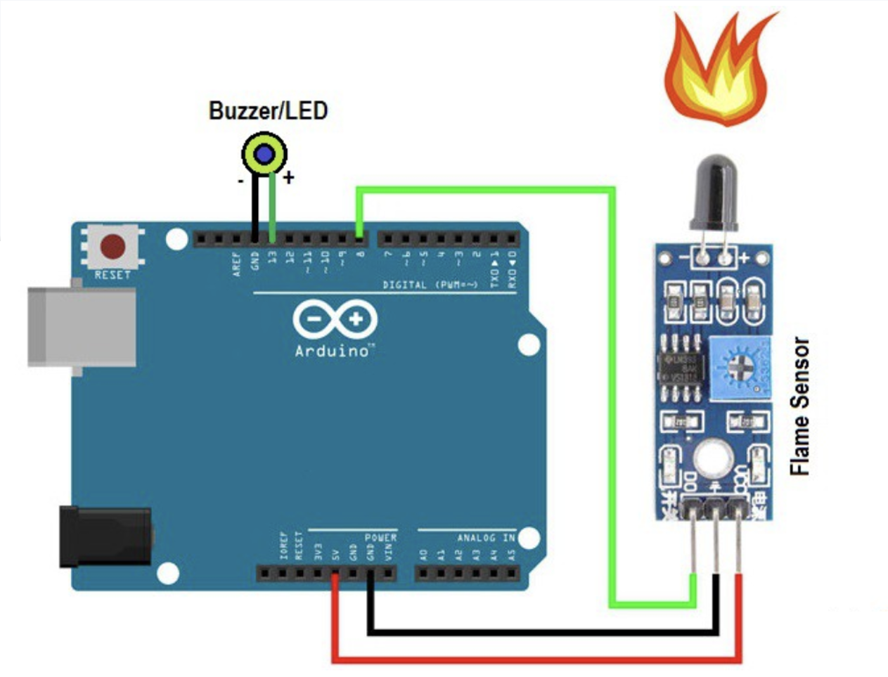
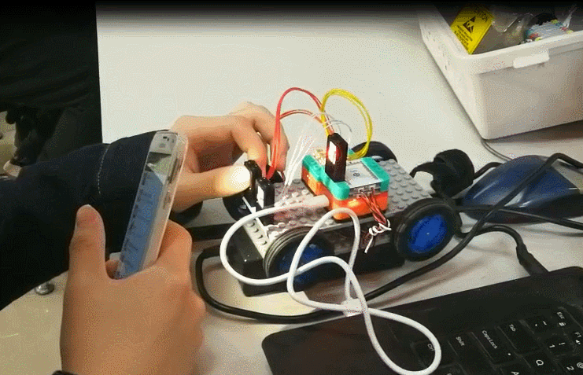
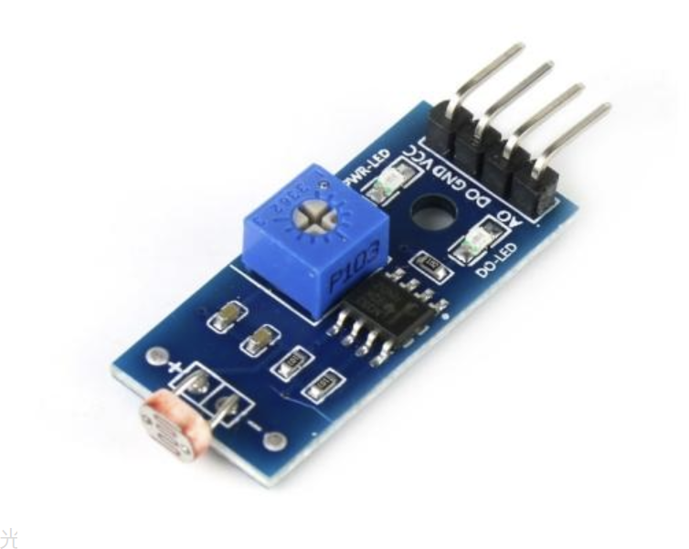
Innovation 2: Emergency control
Detect flame and give warning
Avoid robbers by checking strong light
Fire/flame
Alarm
Photosensitive/light Alarm
GROUP 16

Slide 10
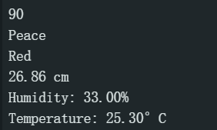
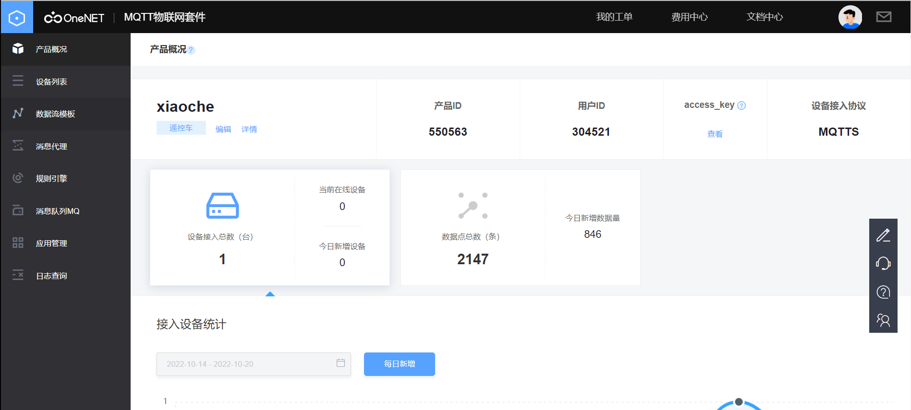
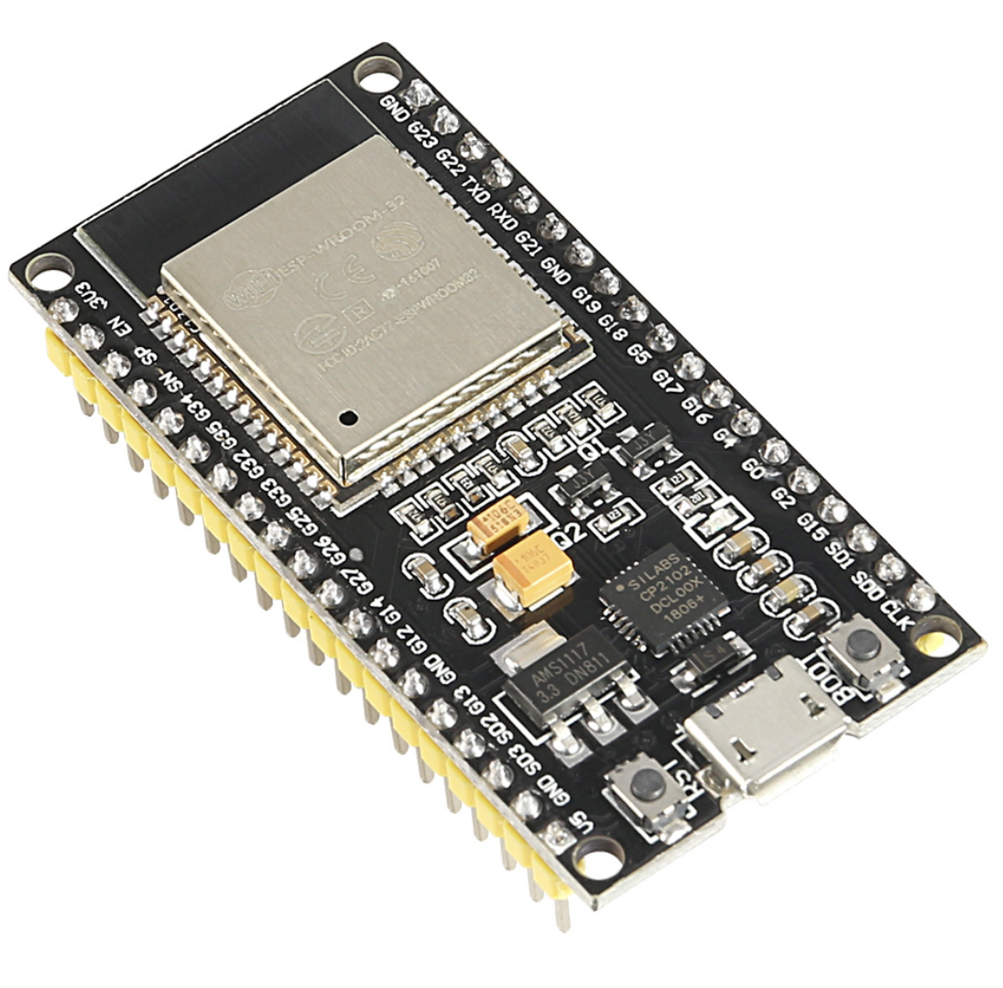
Innovation 3: Wi-Fi wireless transmission
Wi-Fi connection
upload
sensor ESP32
Step 1. Sensors read data from the environment
and transmit them to the main board.
Step 2. The main board exchanges data to esp32.
Step 3. Esp32 establishes a transmission protocol with the OneNET platform and uploads data into the platform.
Step 4. IoT students download the data stream and form an excel sheet.
GROUP 16

Slide 11
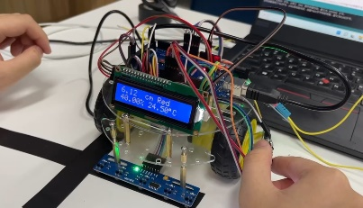

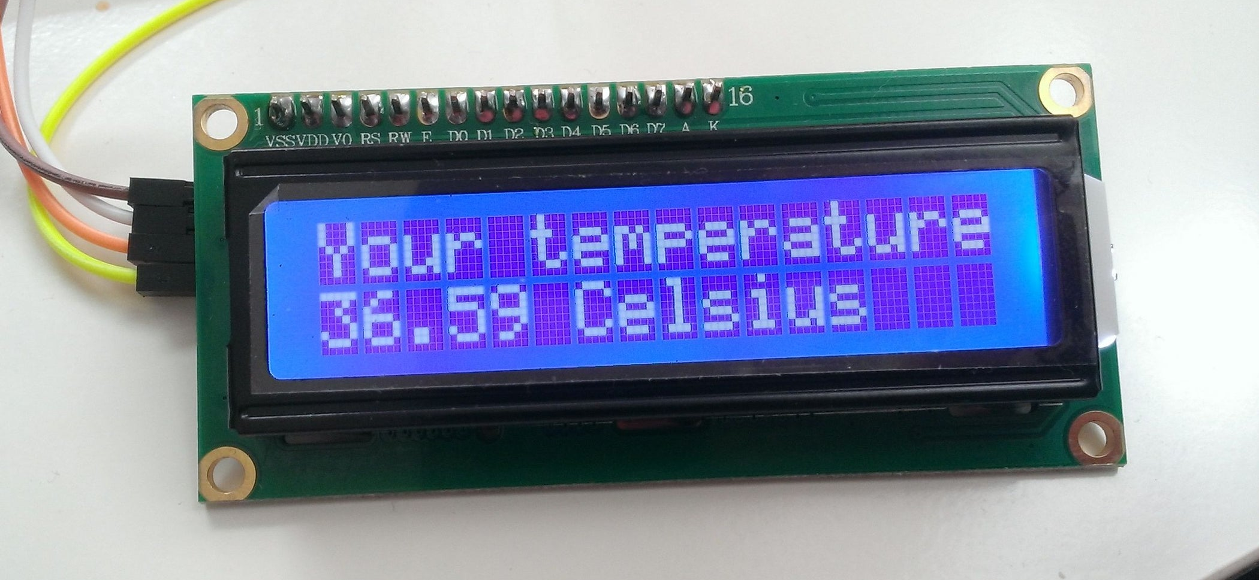
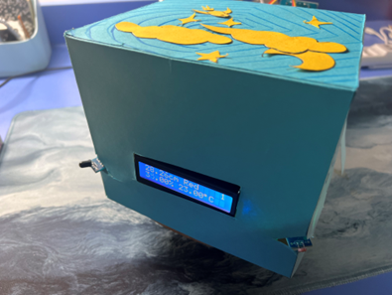
Innovation 4: LCD screen for displaying data
Distance, color, temperature, humidity, warehouse number are all displayed there!
LCD 1602
GROUP 16

Slide 12
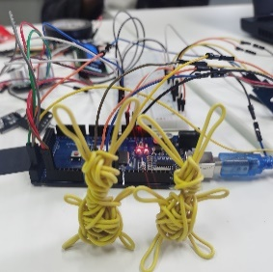
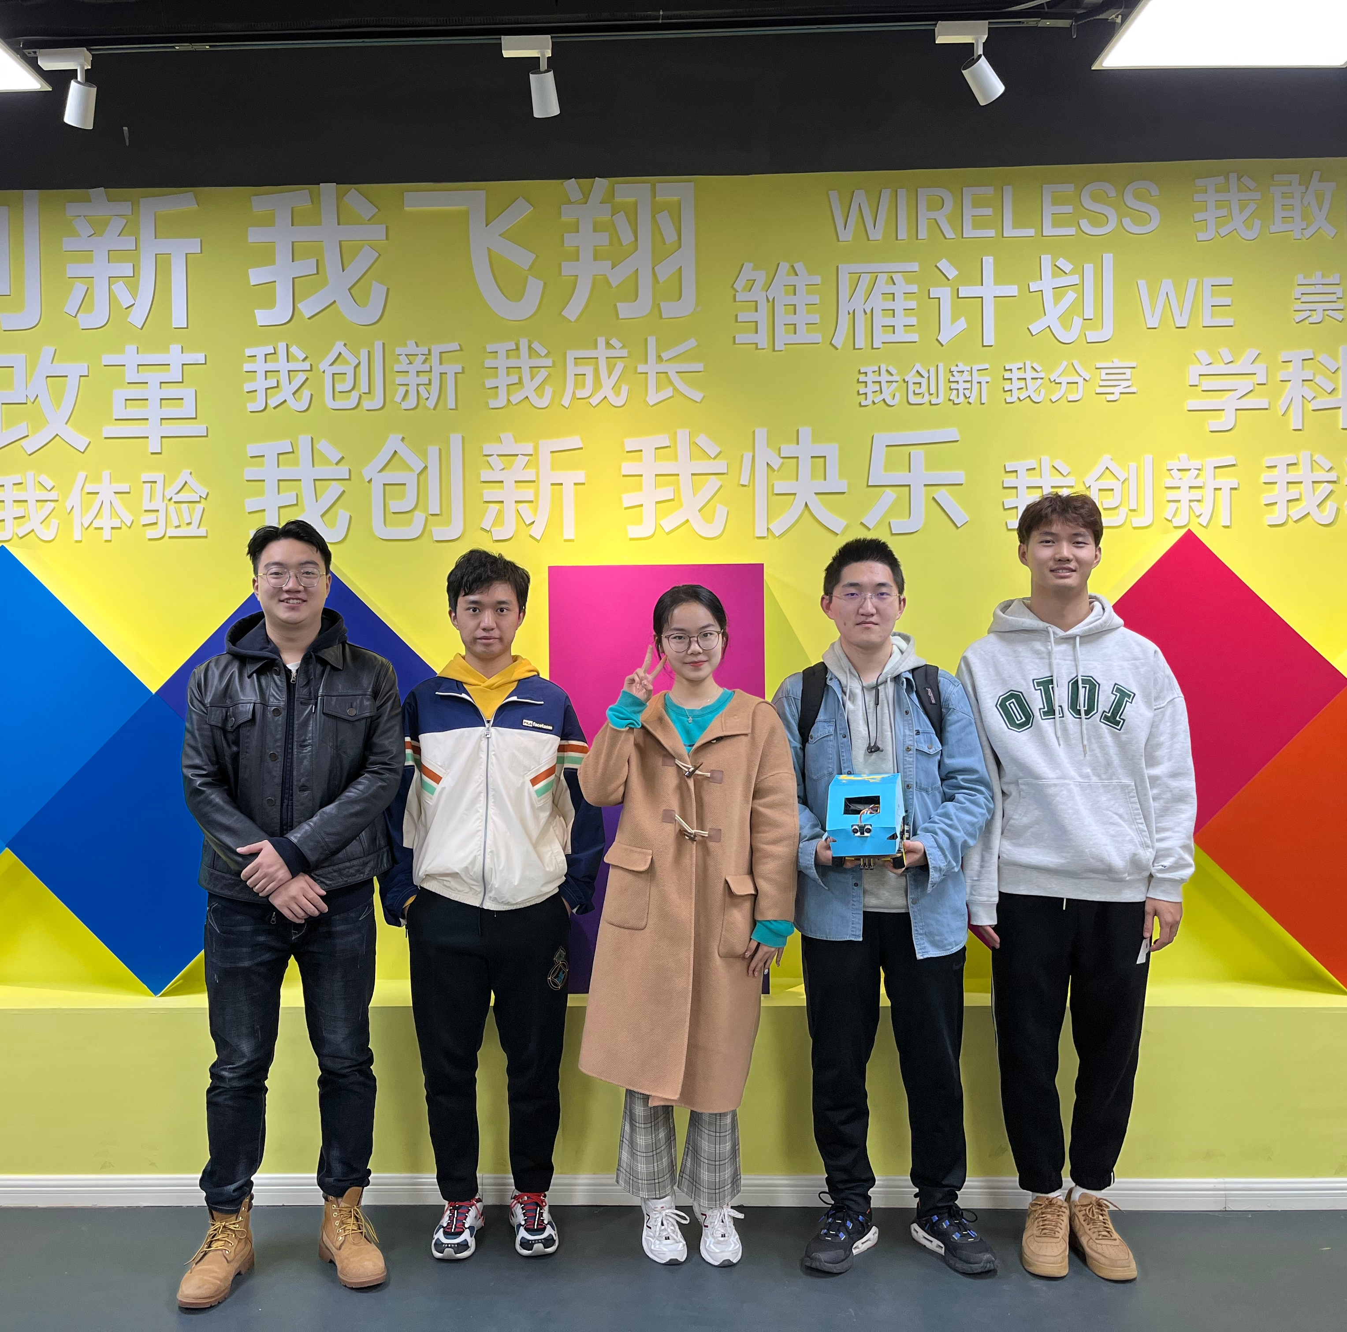
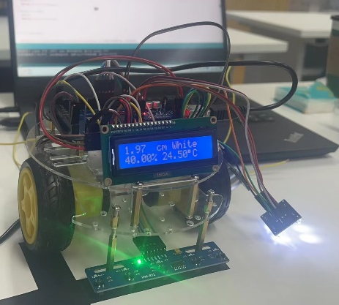

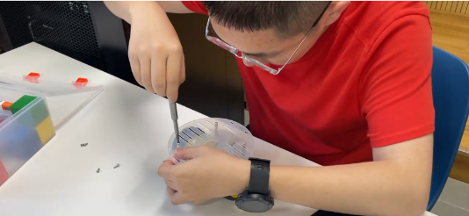
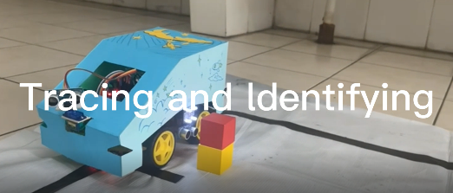
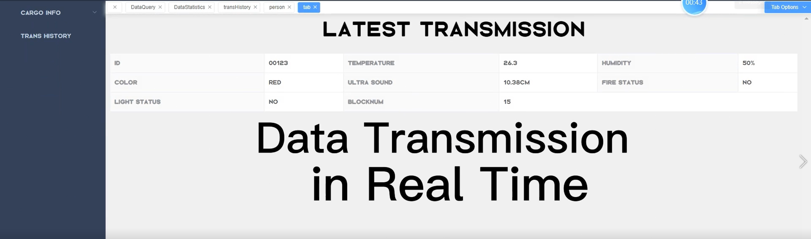
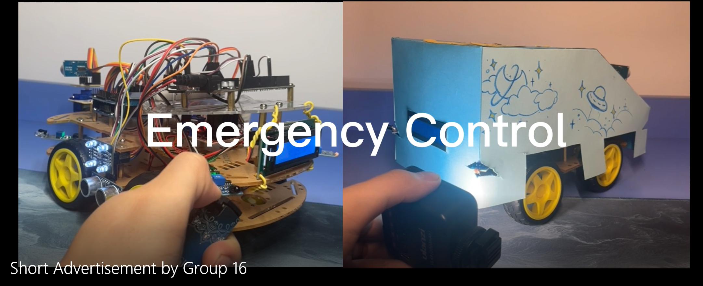
Summary
Good-looking appearance
Multiple comprehensive functions
Good data collection and update
Lower cost
Better commercial use
Perfect smart car from group 16!
GROUP 16

Slide 13
Web Design
Database Management &
Administrator Side Software
E-Commerce
Team members：
Jingru Dai
Xinyi Li
Xianglong Qin

Slide 14
01
Mission Requirements
02
Technology
CONTENTS
03
Database
04
Function
05
Business Analysis

Slide 15
Mission Requirements
01
PARTONE
The first unit

Slide 16

Mission Requirements
Mission Requirements
Our e-commerce major is mainly responsible for designing databases with the IOT major and designing administrator website with the following functions:

Slide 17




Mission Requirements
1. Allow administrators to log in and log out.
2. Allows administrators to query and edit warehouse information, create and delete warehouses.
3. Allows administrators to query and edit worker information, create and delete workers.
4. Display the cargoes status (such as cargoes location) and information (such as cargoes type) of each warehouse.

Slide 18
Technology
02
PARTTWO
The second unit

Slide 19




Technology
In terms of technology, we mainly used
ElementUI plus
mybatis
Vue
Spring boot
jwt
mysql
and other technologies……
plus
Hutool

Slide 20
Database
03
PARTTHREE
The third unit

Slide 21
Database
In terms of databases, we have four entities.
01/04
The first one is used to store administrator information, such as AdministratorID, Username and Password. AdministratorID is the primary key.
Entity | Attribution | Type | Meaning
administrator | AdministratorID | int | distinguish administrators by ID
 | Username | char | administrator name
 | Password | char | administrator password
02/04
Entity | Attribution | Type | Meaning
cargo | Cargo ID | int | distinguish cargoes by ID
 | Cargoname | char | cargo name
 | Type | char | carge type
 | Postion | char | location of cargoes(IOT)
 | price | double | store carge price
 | Shelfnumber | char | the shelf number of the cargos
 | Columnnum | char | the column where crgoes are placed on the shelf
 | Floornum | char | the floor where crgoes are placed on the shelf
The second one is used to store cargo information, cargoID, cargoname and so on. It also records the location of the cargo.

Slide 22
Database
03/04
04/04
The third one is used to record the relationship between cargoes and warehouses, and record which cargoes are stored in each warehouse.
The last one is used to store worker informatin such as workerID, password. Worker ID is primary key.
Entity | Attribution | Type | Meaning
warehouse_has_cargo | warehouseID | int | distinguish administrators by ID
 | cargoID | int | ID of cargoes stored in the warehouse
Entity | Attribution | Type | Meaning
worker | WorkerID | int | distinguish workers by ID
 | Password | char | worker password(IOT)
 | Gender | char | worker gender
 | IDCardnum | char | worker ID number
 | Name | char | woker name
 | Warehouse-warehouseID | int | warehouse where workers work(IOT)

Slide 23
Function
04
PARTFOUR
The forth unit

Slide 24

Function
(1)Login
On the homepage of the website, users can choose to log in as administrator or worker. Our e-commerce major is mainly responsible for the realization of administrator functions.

Slide 25


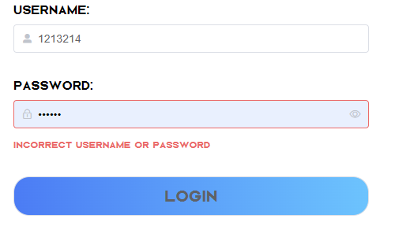

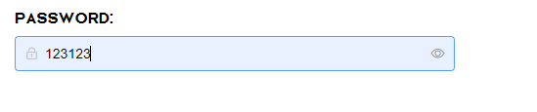
Function
The administrator needs to enter the user name and the corresponding correct password to login.
01
If the user name and password are incorrect, the administrator will not be able to log in.
02
The length of the user name should be 5-10.
03
The password is hidden by default. If you want to see the password, you can click the "eye" on the right to display the password.

Slide 26
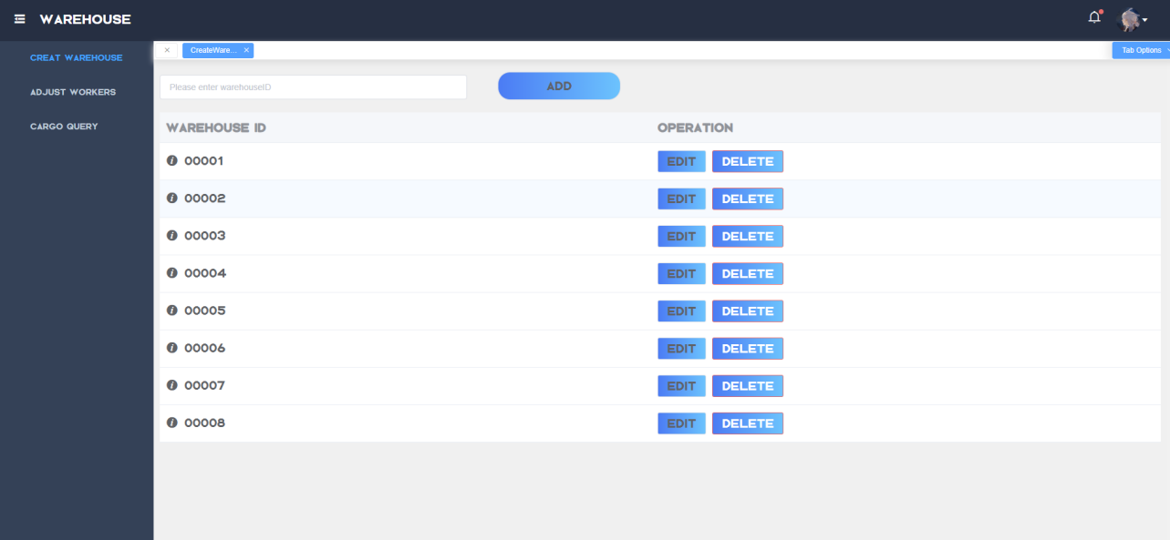
Function
(2) Query warehouse information and manage warehouses
The administrator can query all warehouse information, edit or delete the warehouse. The administrator can also create a new warehouse by entering the warehouse ID.

Slide 27
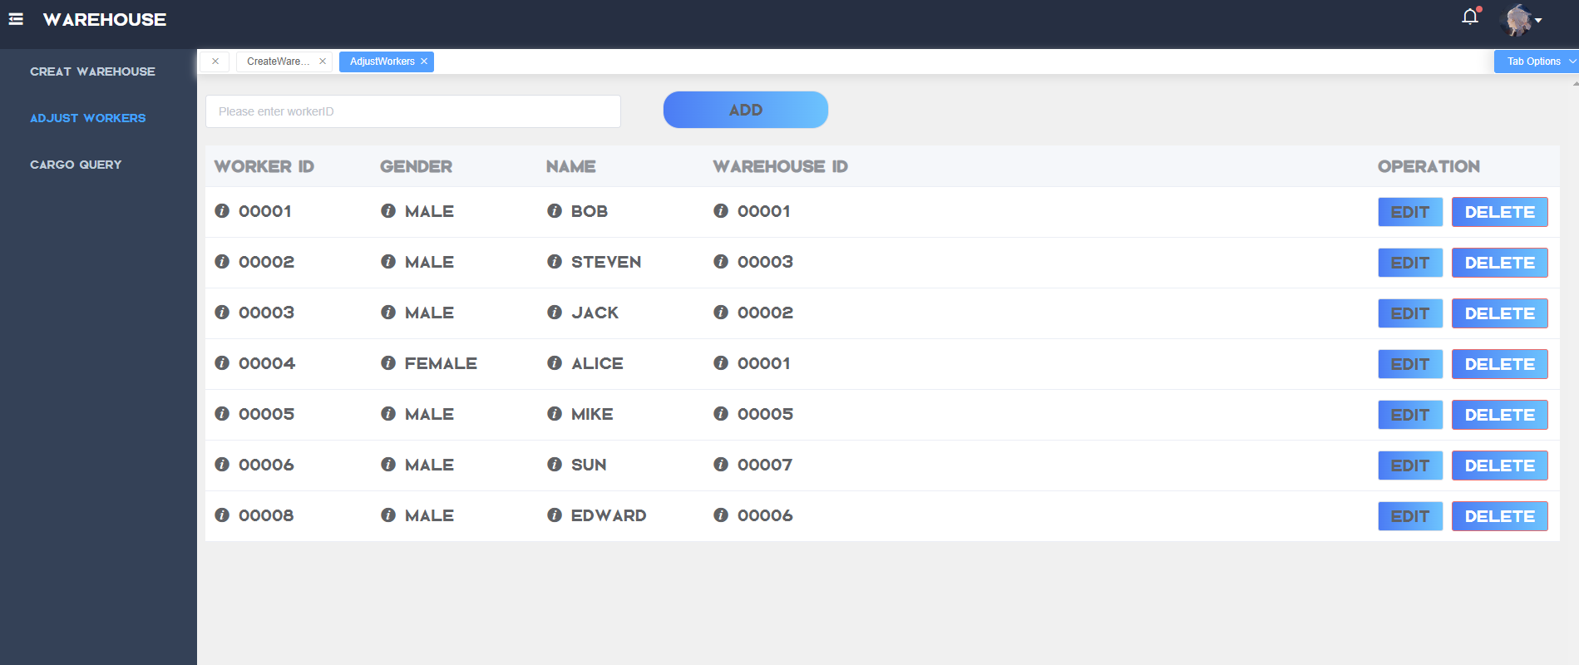
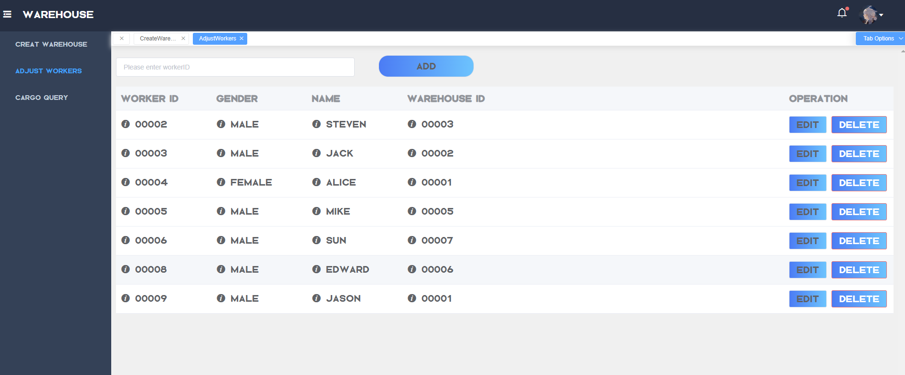
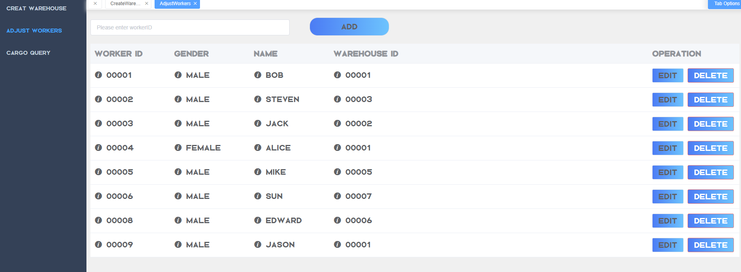
Function
(3) Query worker information and manage workers
Administrator can also add workers. For example, add a new worker with values(00009, Male, Jason, 00001)
01
02
03
The administrator can query all worker information and edit their basic information.
If the worker no longer works in the warehouse, the administrator can also delete the worker. For example, delete the worker whose ID is 00001.

Slide 28
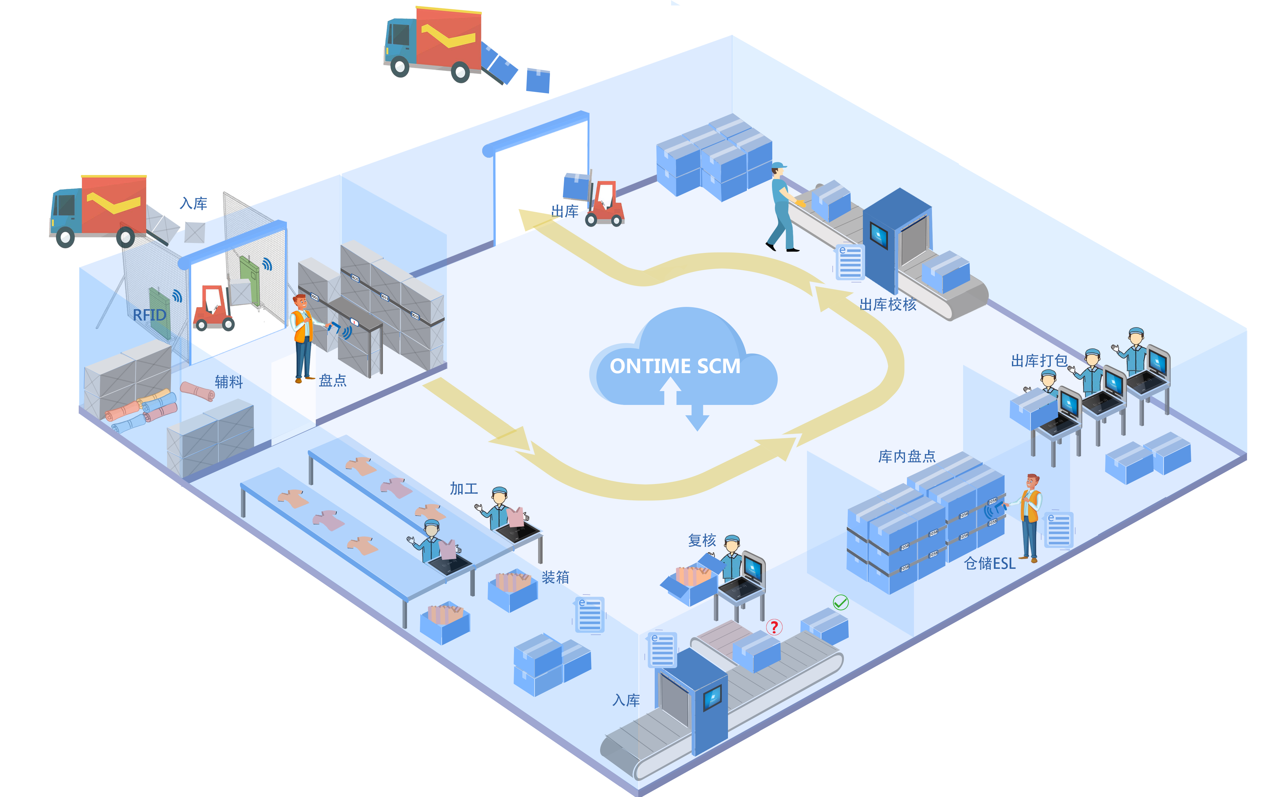
Function
(4)Data Visualization
We have realized data visualization so administrators can clearly see the data distribution and changes.
For example ,
we select date range: 2022-07-07 ~ 2022-07-16.

Slide 29
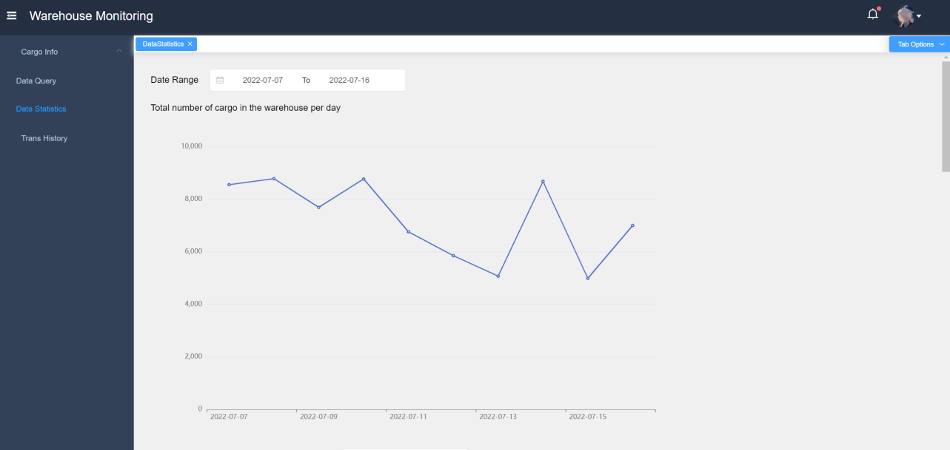

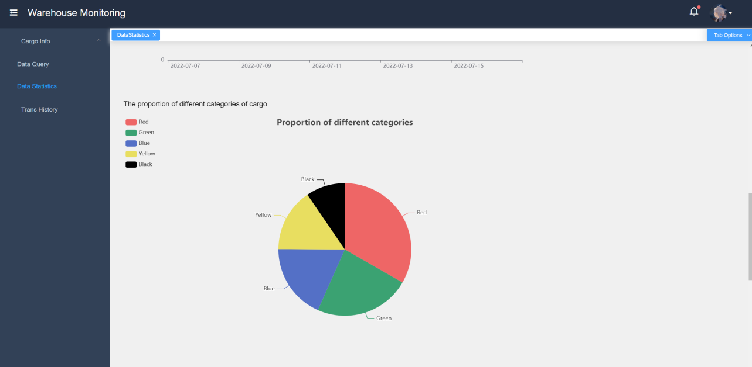
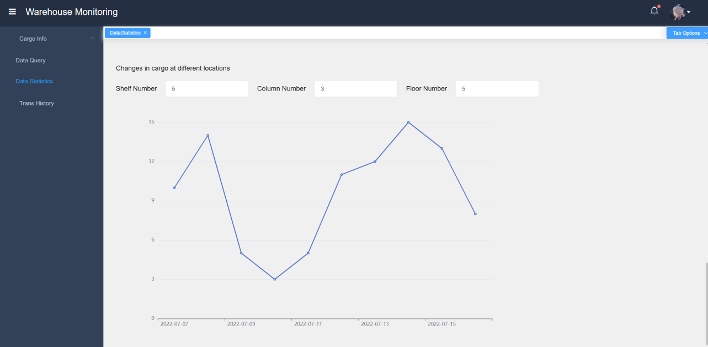
Function
This is the line chart of the change of the total quantity of goods in the warehouse per day.
Line chart of the change in the quantity of a category of goods.
01
02
03
04
Pie chart of the proportion of goods in different categories (averaged over the time period).
Line graph of the change in the quantity of goods at different locations

Slide 30
Business Analysis
05
PARTFOUR
The fifth unit

Slide 31
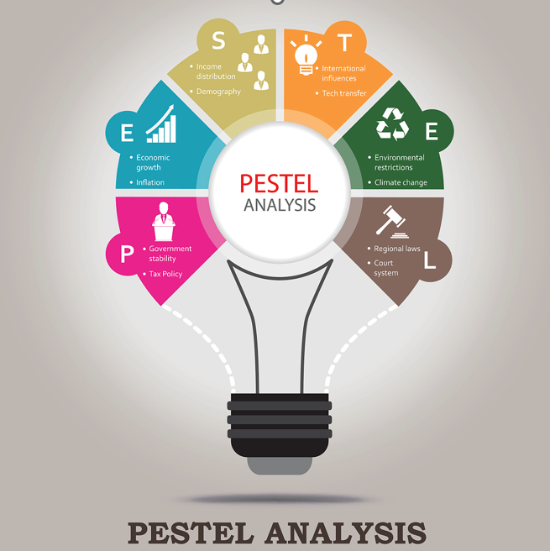
Business Analysis
PESTEL
Political
Economic
China has issued many policies vigorously encourage and support the intelligent logistics equipment industry.
In the future, the demand for intelligent warehousing market will be further released. It is estimated that by 2023, the scale of the intelligent warehousing market will reach 197.5 billion yuan.
Legal
Sociocultural
The Ministry of Industry and Information Technology and other competent departments have successively issued a series of legal documents to vigorously support the development of the industry.
in society, with the increase in land use costs and labor costs, storage costs have also increased significantly.
Environmental
Technological
In recent years, China's intelligent warehousing scheme has enjoyed a strong momentum of going to sea, and the first echelon of logistics robot enterprises have made remarkable achievements.
The development of Internet of Things technology and 5G technology has realized the remote monitoring and maintenance of the logistics equipment system.

Slide 32
Business Analysis
SWOT
Strength
Our system is user-oriented and can distinctly show the goods in the warehouse on the web page, which is easy for customers to use.
Our warehouse management system simulates the real warehouse situation and is professionally designed. We utilize various sensors for goods identification, environmental monitoring, and emergency control.
Weakness
·User-oriented and can distinctly show the goods in the warehouse on the web page
·Simulates the real warehouse situation.
·Utilize various sensors for goods identification, environmental monitoring, and emergency control.
·The stability and creativity still need to be improved.
·Only developed the web version, without expanding the function into application on cellphones for realizing better convenience.
01
02
03
04
Threat
Opportunity
·Attract more users with a relatively low price.
·Find investors and sponsors who are interested in our project.
·Combine with major supermarkets and apply the system in supermarket sales.​
·Competitors increase.
·We need to invest a lot of money and manpower to do the publicity.
·We must be creative as soon as possible or we will lose market competitiveness.

Slide 33
Business Analysis
4P Strategy
01
Product
02
Price
An intelligent warehouse management system, which ensures the speed and accuracy of data input in all links of cargo warehouse management.
When the enterprise expands to medium scale or above, the price of a customized system usually needs between 100000 and 500000, depending on the functional category, difficulty, development workload, pricing, and positioning of service providers, etc.
03
Promotion
04
Place
Set up offline experience stores.
Cooperate with e-commerce websites.
Offer discounts to customers.
Provide VIP service for users.​
Multiple payment methods are supported.
Provide after-sales services.
First of all, we start our business in the first-tier cities with developed logistics and e-commerce industries. Then we expand the business, establishing subsystems in other cities.

Slide 34
Database
And
Interface
Hardware-database interface & client-side software
Team members：
Yifan Yang
Zhuoheng Han
GROUP 16

Slide 35

Login Page
The password is hidden by default.
But you can click the little "eye" button on the right to show your password
GROUP 16

Slide 36
The length of the Username should be between 5 and 10
If the username and the password are not matched
GROUP 16

Slide 37

Change Password
GROUP 16

Slide 38
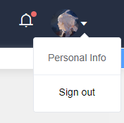
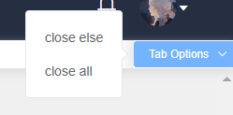
Basic Interface Functions
GROUP 16

Slide 39
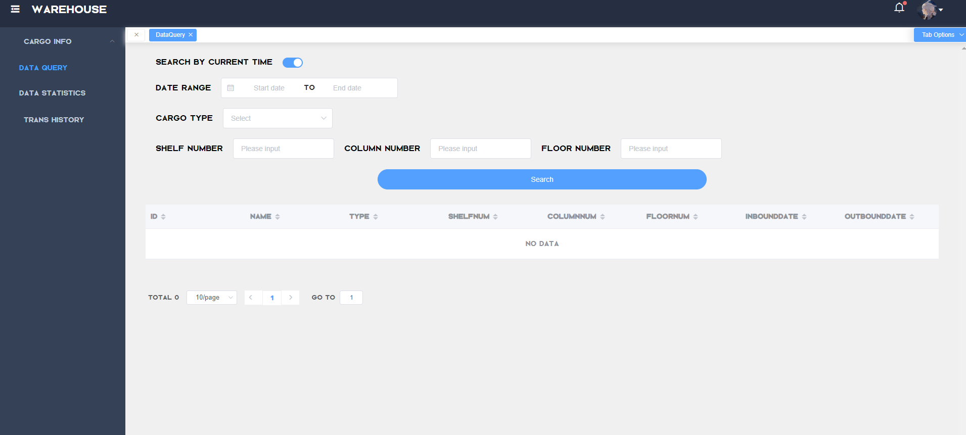
Data Query
GROUP 16

Slide 40
EXAMPLE：Search for type = red , shelfNum = 1, ColumnNum = 2, FloorNum = 3 during 2022-06-25 ~ 2022-07-01
Da
GROUP 16

Slide 41



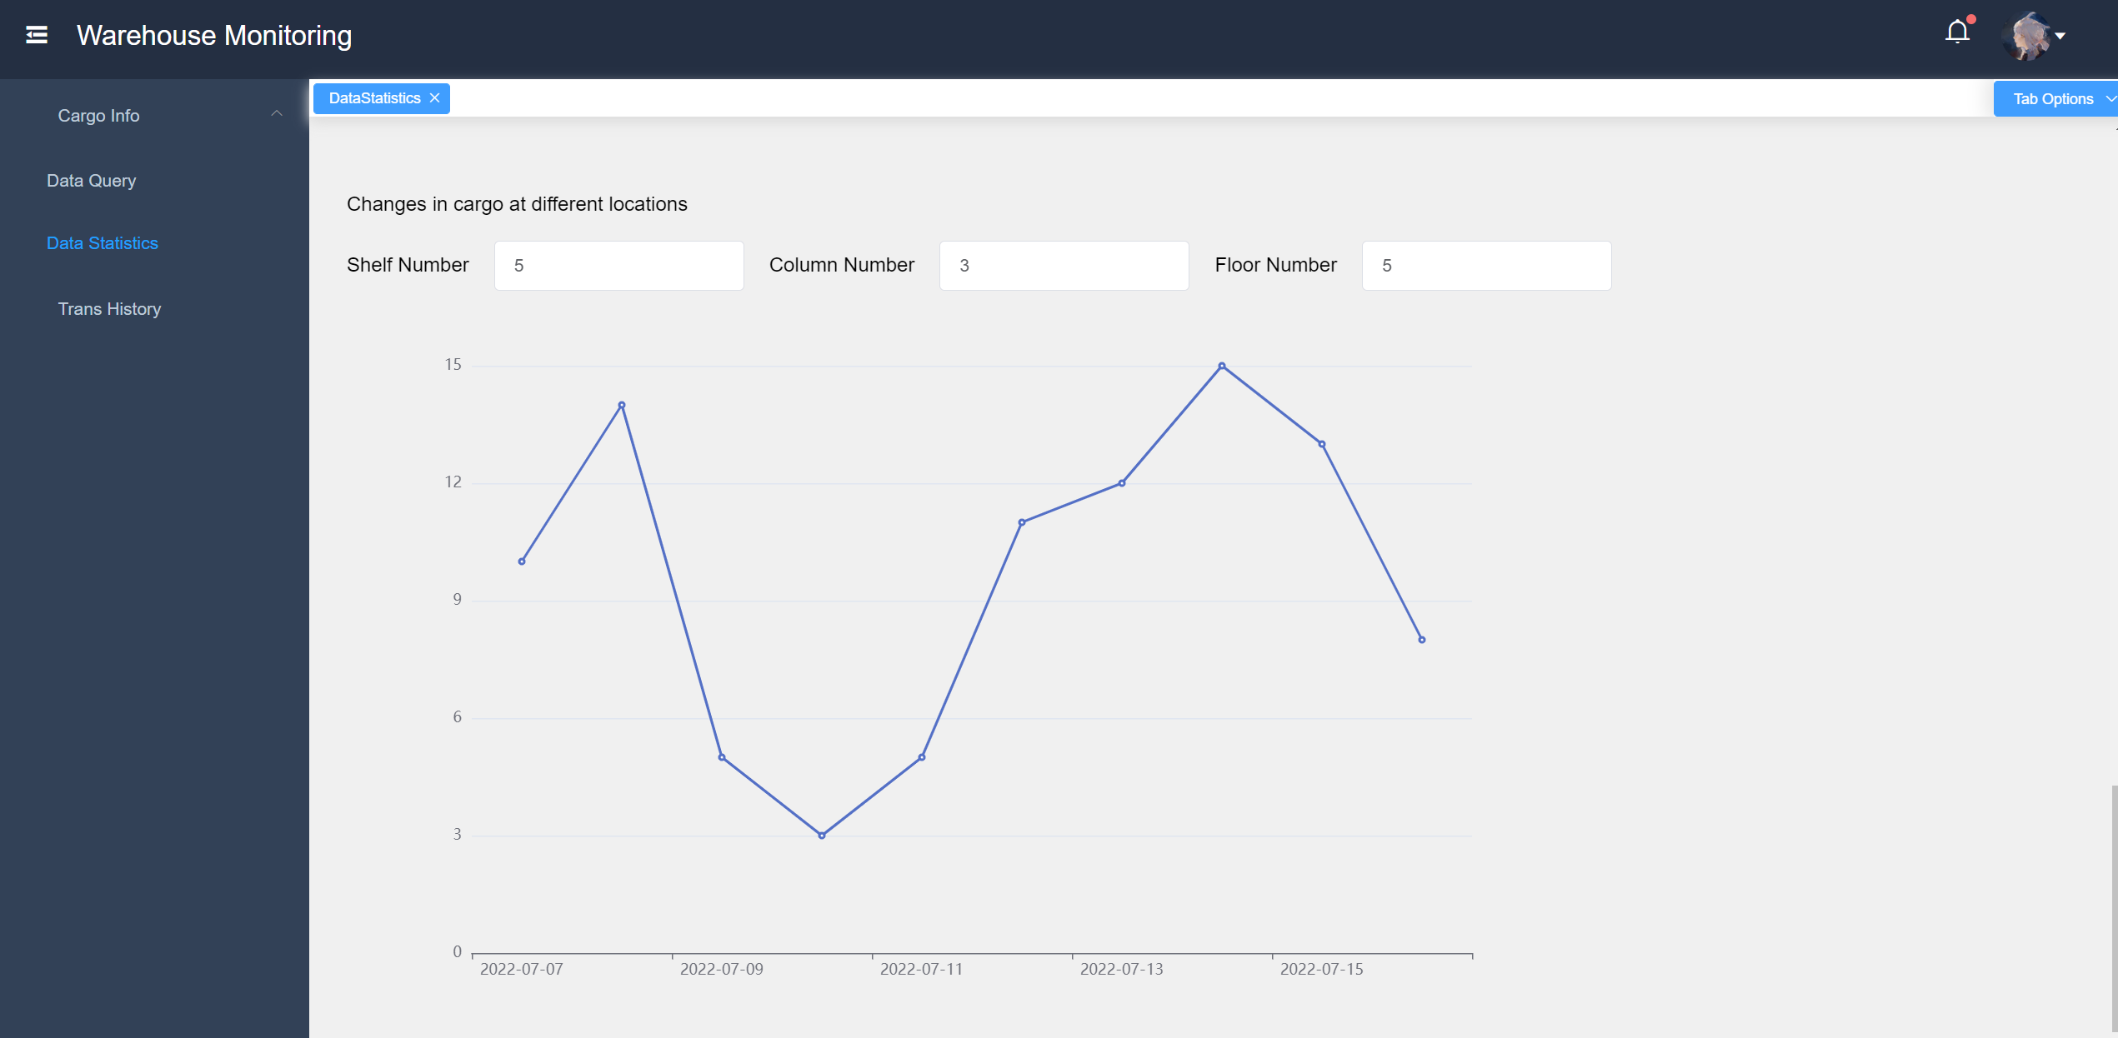
Data Statistics
GROUP 16

Slide 42
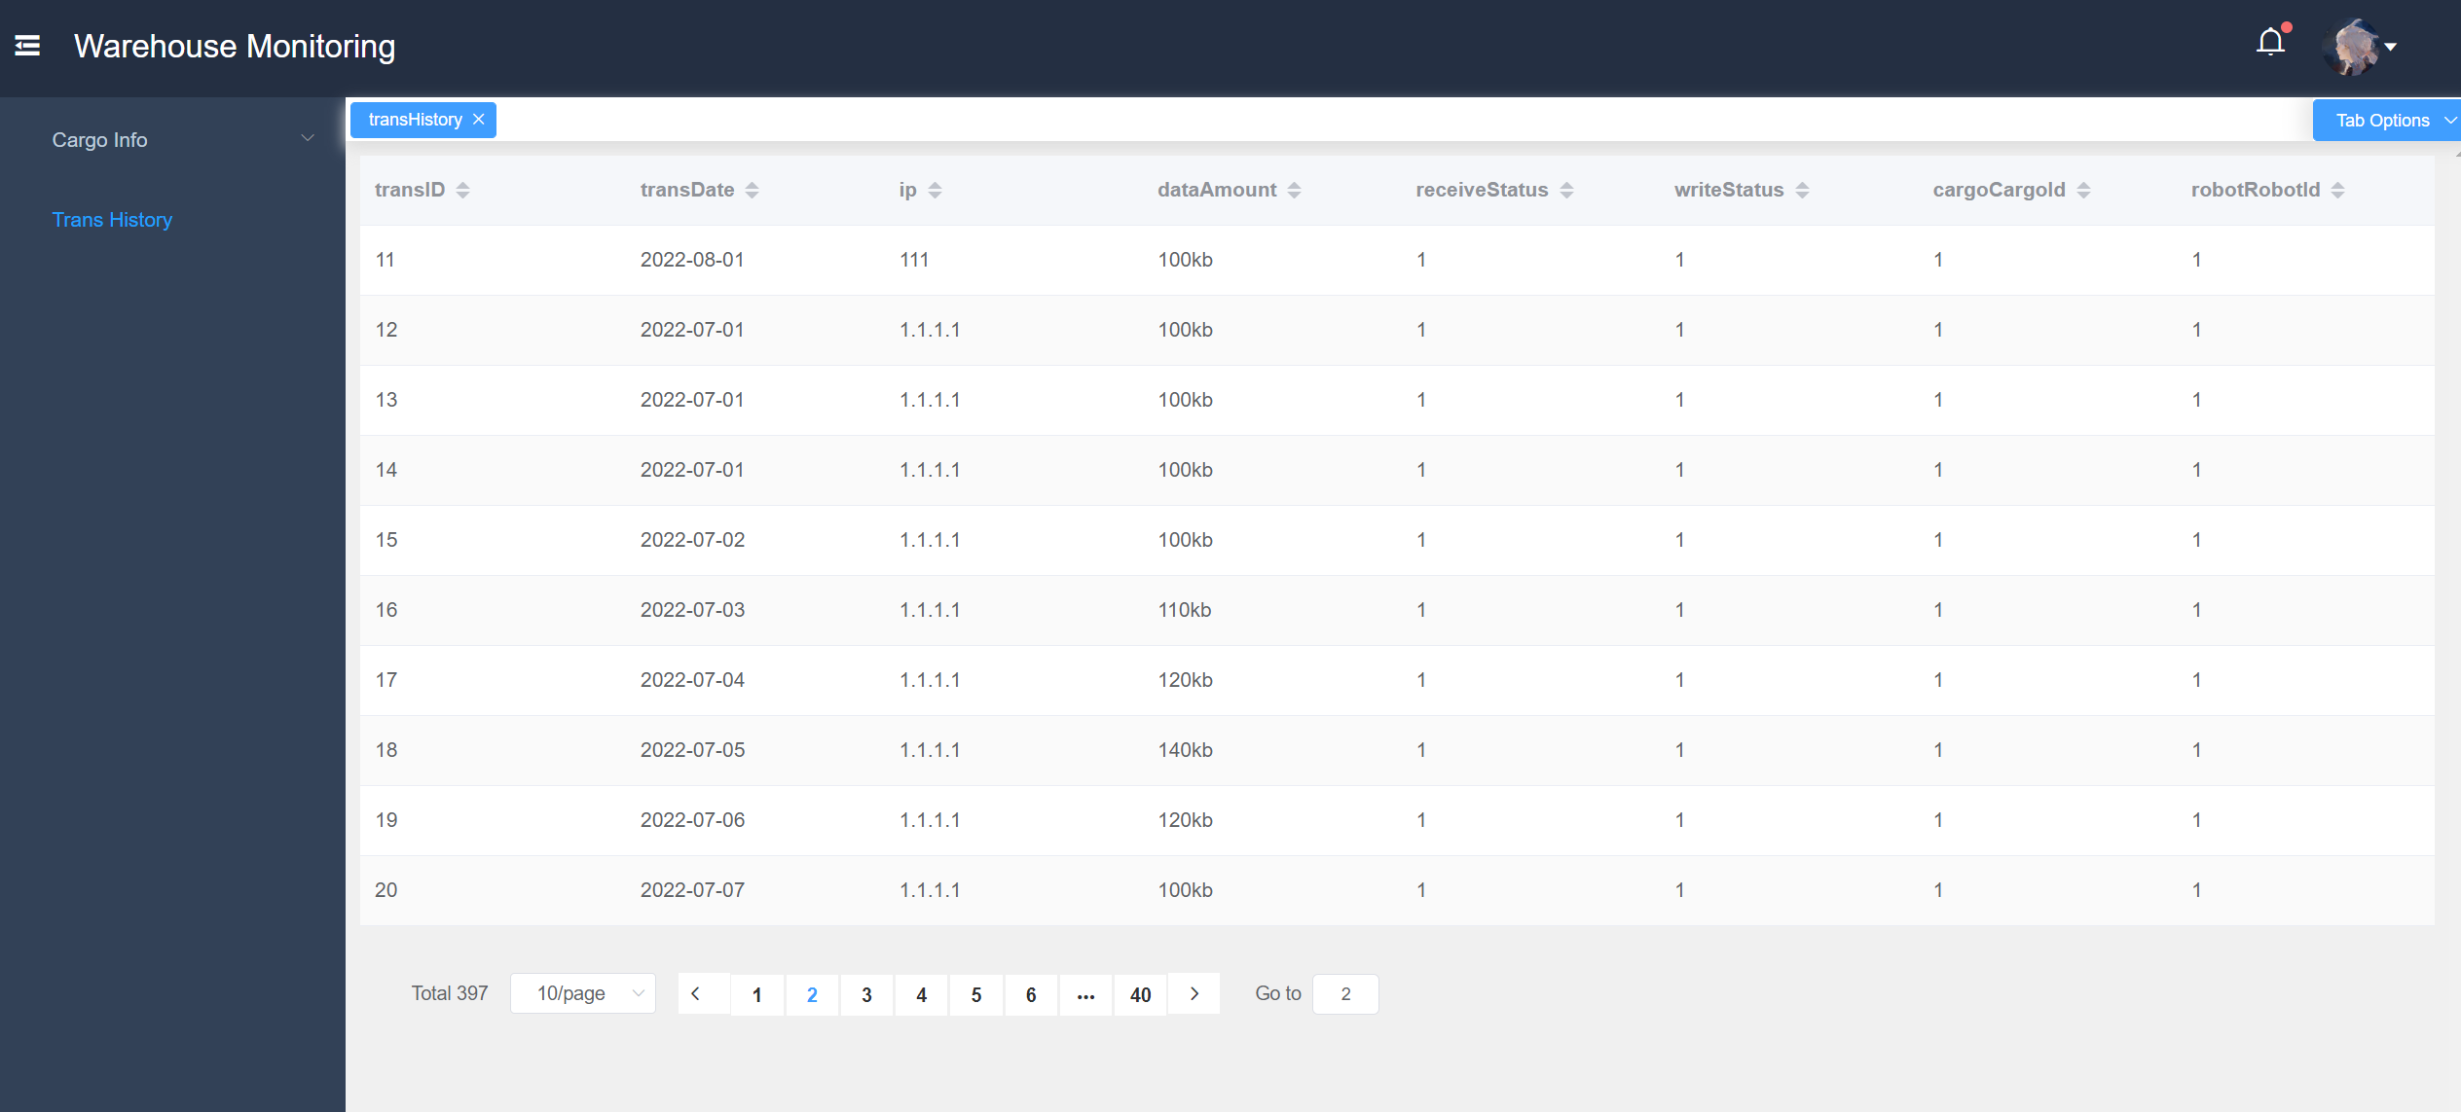
Transmision History
GROUP 16

Slide 43
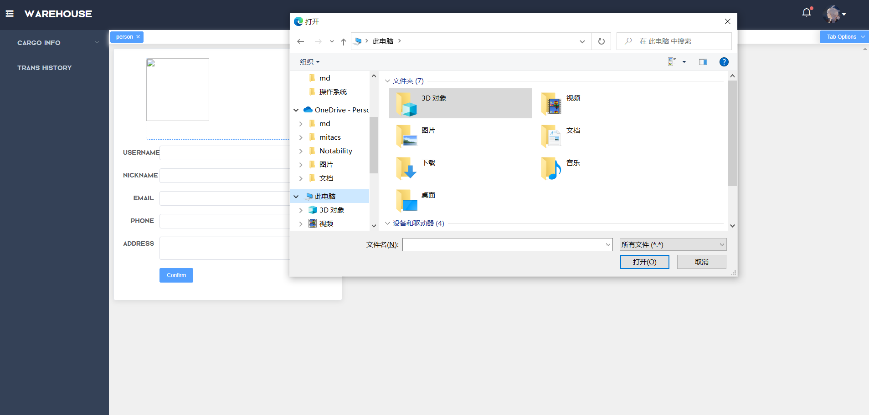
Personal infomation
GROUP 16

Slide 44
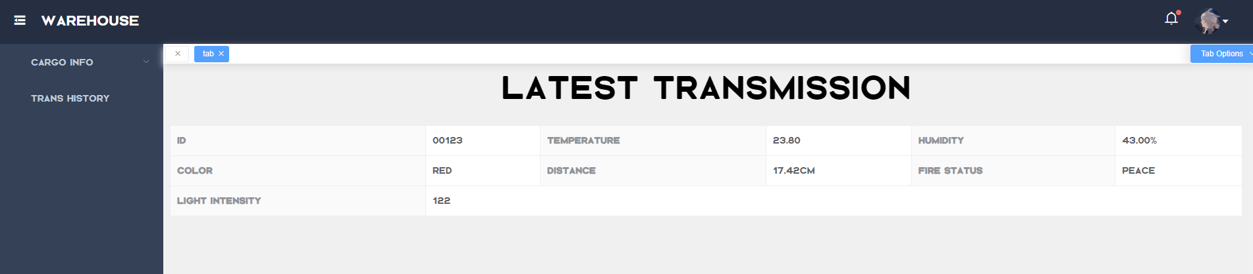
Latest Transmission
GROUP 16

Slide 45
Summary
Summary
Summary
Summary
Summary
Summary
GROUP 16

Slide 46

Thanks
For
Watching
Design of the circuit and implementation of the functions
Team members：
Tangxun Wu
Boyang He
Guanyi Lin
Dongze Sun
Weiping Kong
Jingru Dai
Xinyi Li
Xianglong Qin
Yifan Yang
Zhuoheng Han
GROUP 16

